Slide 1
Team 1 Project 1
G
Mary O., Sydney, Craig, Galen

Slide 2
Introduction
G
Project, Methodology

Slide 3
Zip-Codes & House Price Index
G
Issues & Research Questions:
Explore relationships between house prices and economic & geographic factors (schools & green spaces)
Introduction to the Datasets:
Redfin home price history
Federal Reserve housing market & macro economics
Geographic information APIs (green space, school, etc.)
Housing data:
Sales per year per ZIP
Single-family only
Weighted mean prices across types
Created single unified House Price Index (HPI) anchored to 2012
Economic data:
Recessions: flagged each year
Federal funds rate (drives mortgage rates)
Geographic information:
Centroid of ZIP -> Lat, Lon
Distance to schools

Slide 4
Methodology
G
Data gathering
Data cleaning
Data analysis & reporting
API
Datasets
Aggregating code
Cleaning code
Cleaned datasets
Analysis Notebook
Analysis Notebook
Analysis Notebook
Analysis Notebook
Analysis Notebook

Slide 5
Our Data
G
Descriptions, limitations, etc.

Slide 6
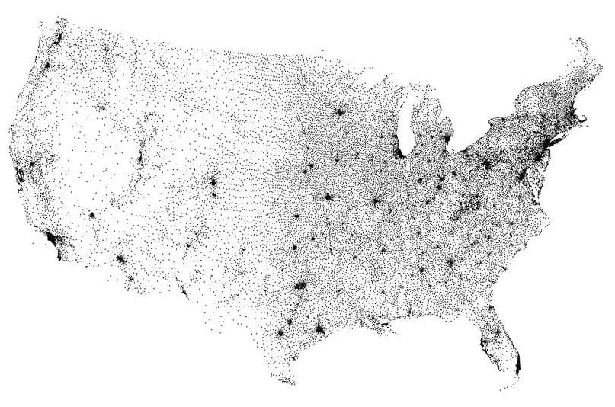
Our Data: Historical ZIP Codes
C
Characteristics and Considerations:
48 years: 1975 to 2022.
13,000 unique Zip Codes.
Zip Codes do not have specific geographic boundaries - ZCTAs are roughly analogous.
Zip codes vary greatly in geographical size and population.
Geographic considerations are not cleanly described by the Zip Code number.
Figure ##: Map of Zip Code Tabulation Area (ZTCA) Centroids

Slide 7
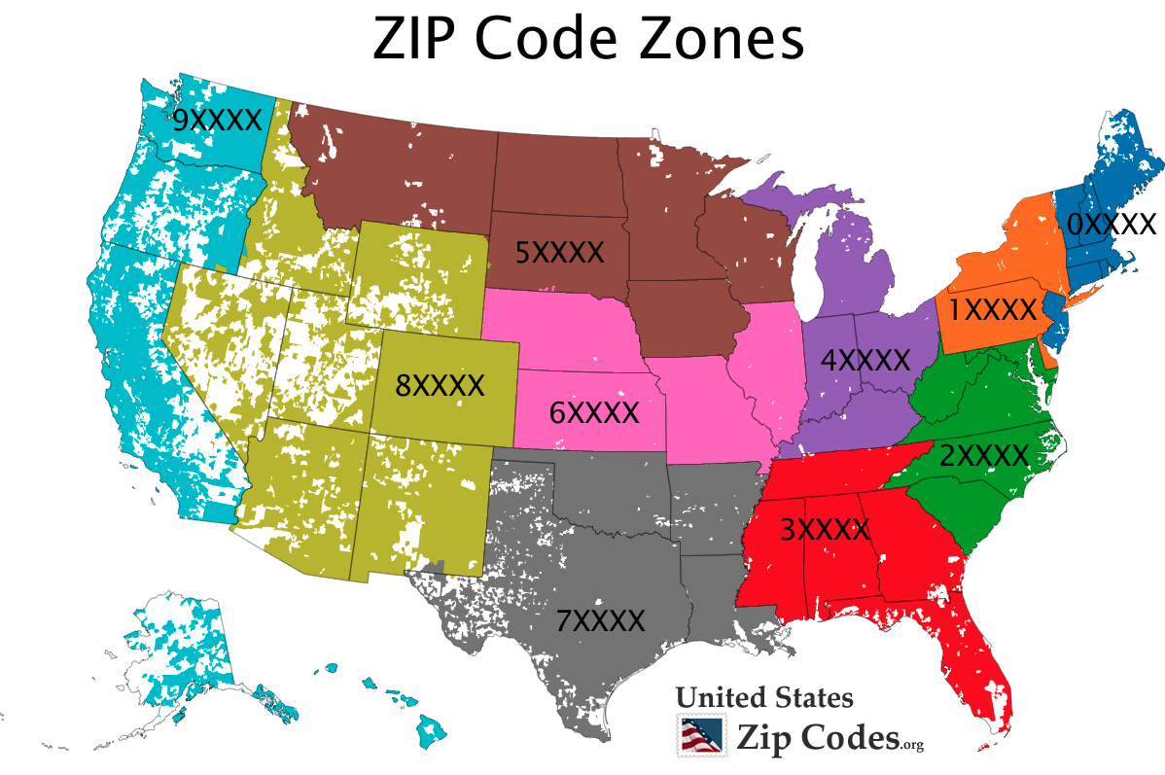
ZIP Code Geography
S

Slide 8
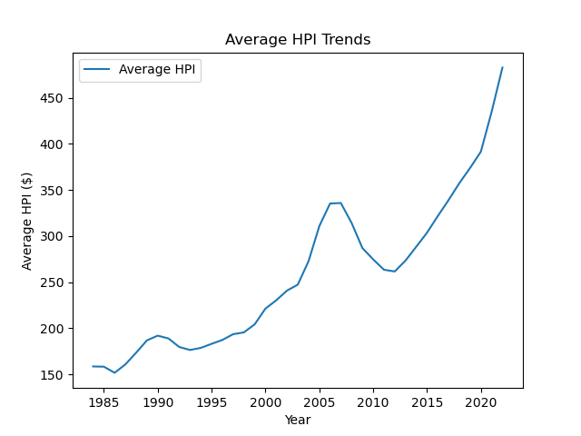
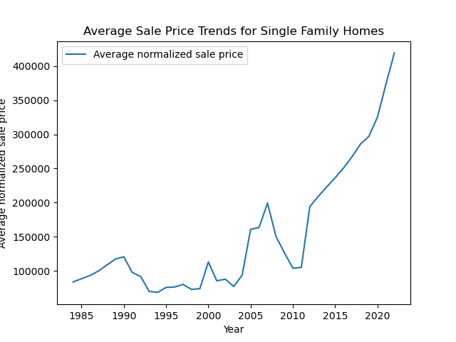
Our Data: Cleaning & Aggregation
S
Method:
Change in HPI from the prior year was computed to determine outliers.
Zip Codes with no data for a particular year were dropped.
Outliers were determined for five longer periods.
Results were stored as .csv files that could be utilized by other group members for further analysis.

Slide 9
House Price Index (HPI) Geography
C
Regions of interest & outliers

Slide 10
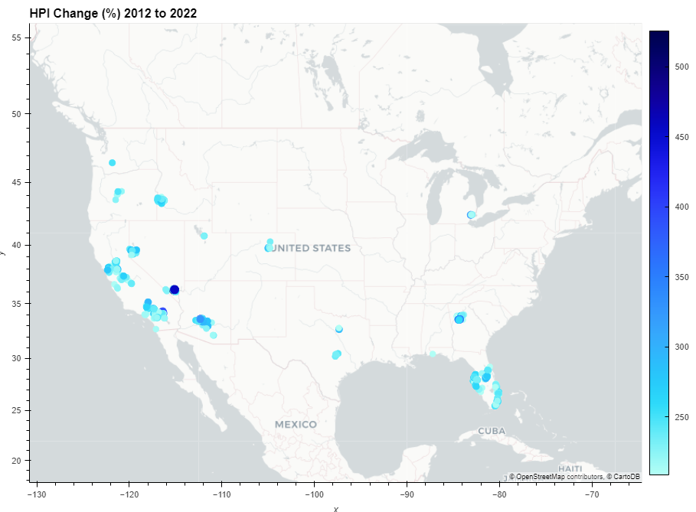
Figure ##:
C
Boise
Bend
Reno
Denver
Sacramento and Bay Area
Las Vegas
Atlanta
Phoenix
Dallas
San Bernardino
Austin
All of Florida

Slide 11
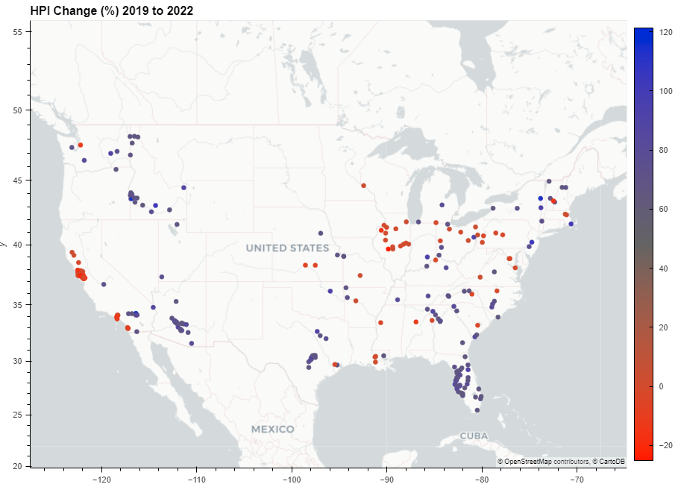
Figure ##:
C
Spokane Area
New England minus Boston
Boise
Rust Belt
Kansas City
Sacramento and Bay Area
Cincinnati
Tulsa
Tennessee, North Carolina
Phoenix
Phoenix
Los Angeles San Diego
Dallas
Atlanta
San Bernardino
All of Florida
Especially Gulf Side
Austin
Tampa

Slide 12
HPI Geography Discussion
Findings:
There are clear regions of the country where HPI declines
Surprisingly, California shows potential weakness in the housing market
Further Work:
It would be interesting to cross-check the period outliers lists to separate one-hit-wonder outliers from stable ones, if any.
It would be possible to use a single file to store all the data, using tags.
Periods with no mathematical outliers – perhaps top and bottom 5%.

Slide 13
HPI: West, Central, East US
S
ZIP Code & Regional Comparisons

Slide 14
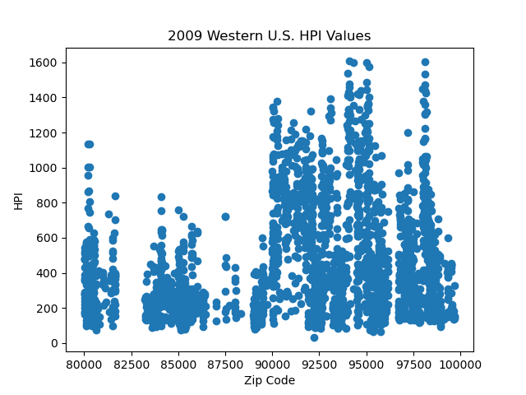
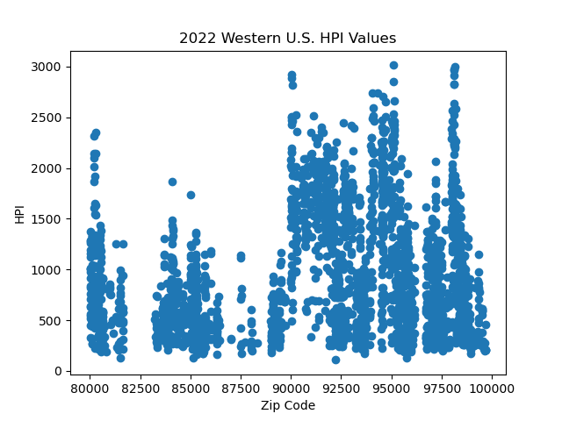
Western US: 2009-2022
S
Western U.S. zip code data includes WA, OR, CA, ID, UT, NV, AZ, NM, CO, & WY

Slide 15
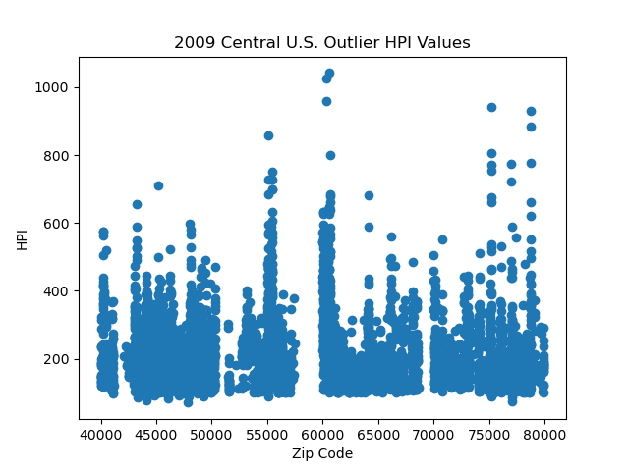
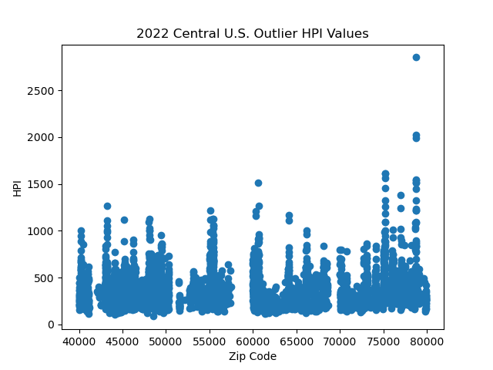
Central US: 2009-2022
S
Central U.S. zip code data includes MT, ND, SD, NE, WI, MN, IA, KS, OK, TX, LA, AR, MO, IL, IN, MI, OH, and KY

Slide 16
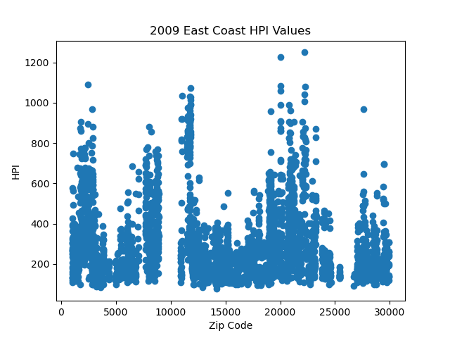
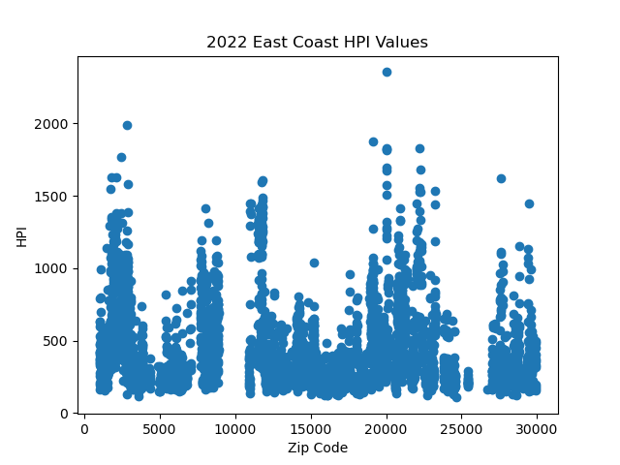
Eastern US: 2009-2022
S
Eastern U.S. zip code data includes ME, NH, VT, MA, CN, RI, NJ, NY, PN, MD, DC, WV, VI, NC, AND SC

Slide 17
US Regional Variation Discussion
S
Findings:
West coast HPIs and HPI growth exceeds the other major regions
This growth is driven by California
Interesting growth locales:
Bend, Oregon
Phoenix, Arizona
Boise, Idaho
Denver, Colorado
Further Work:
Deeper intra-regional variation analysis could reveal interesting pattern and drivers of growth

Slide 18
Schools & Parks
M
Impact of Select Local Conditions

Slide 19
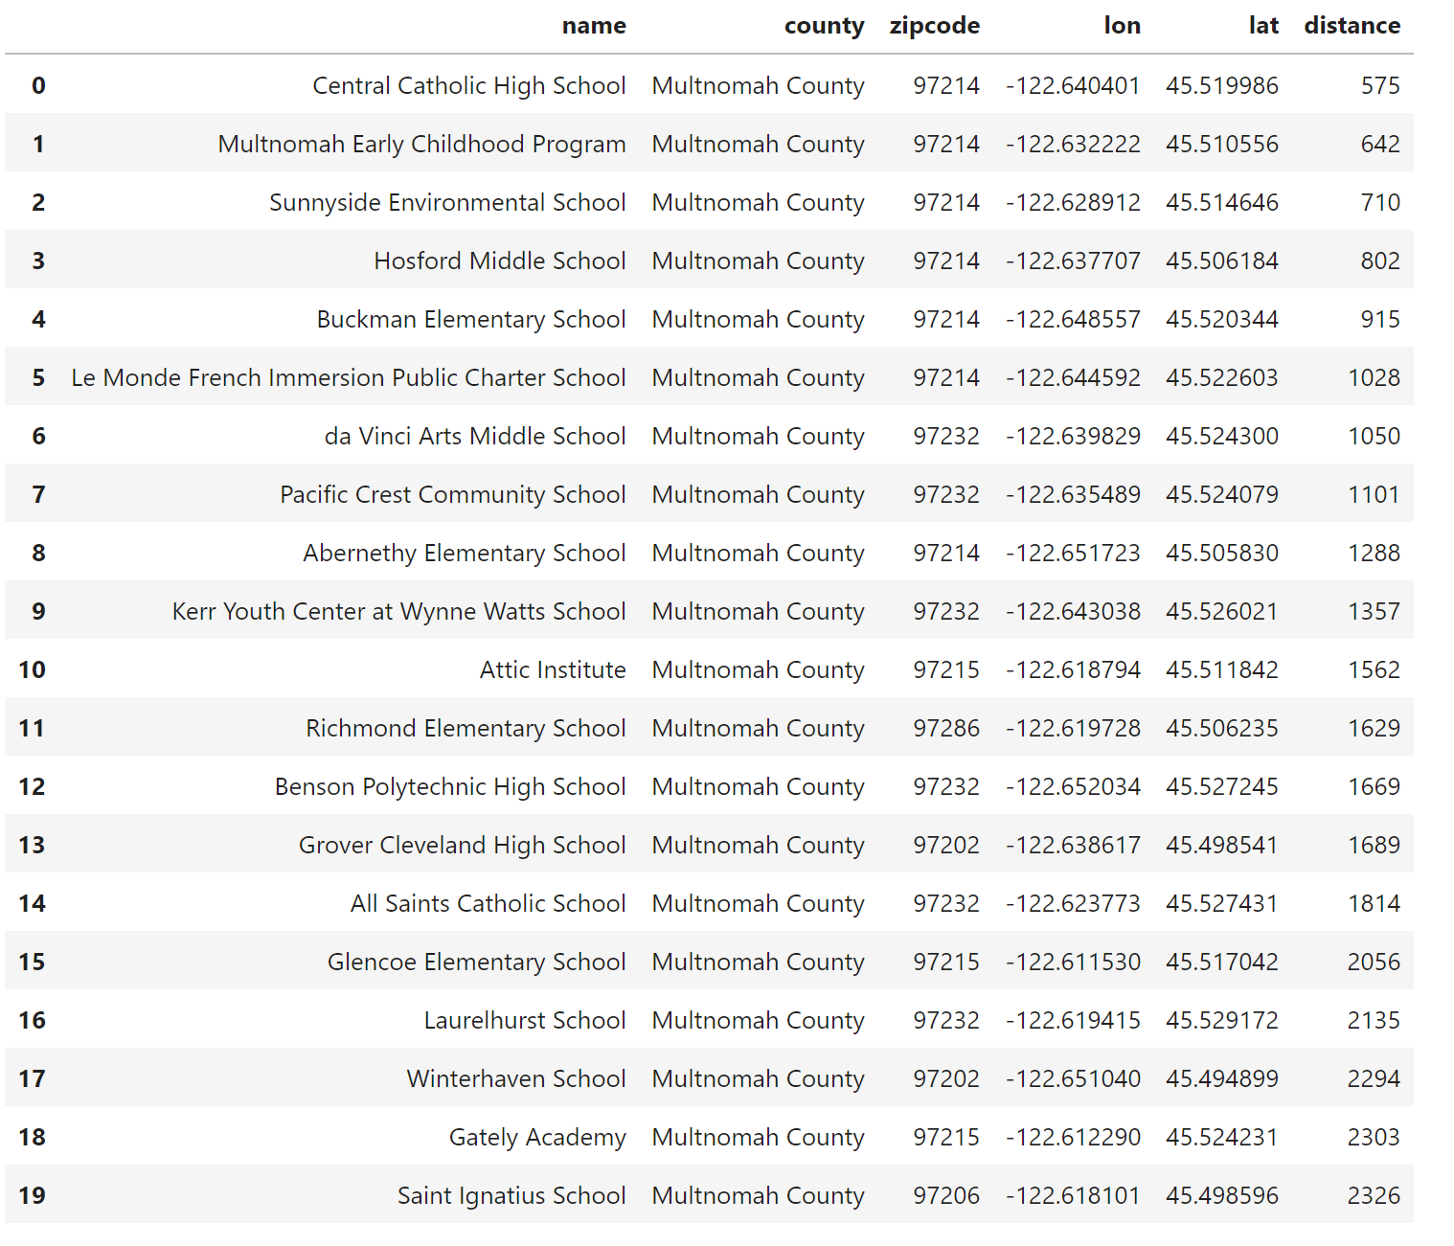
M

Slide 20
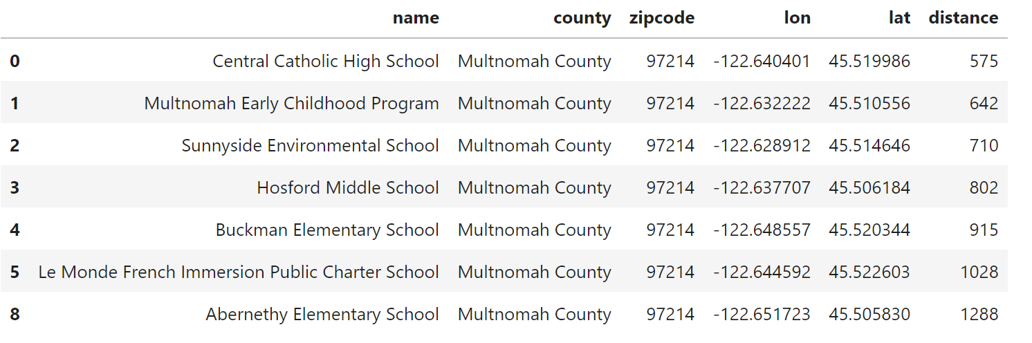
M

Slide 21
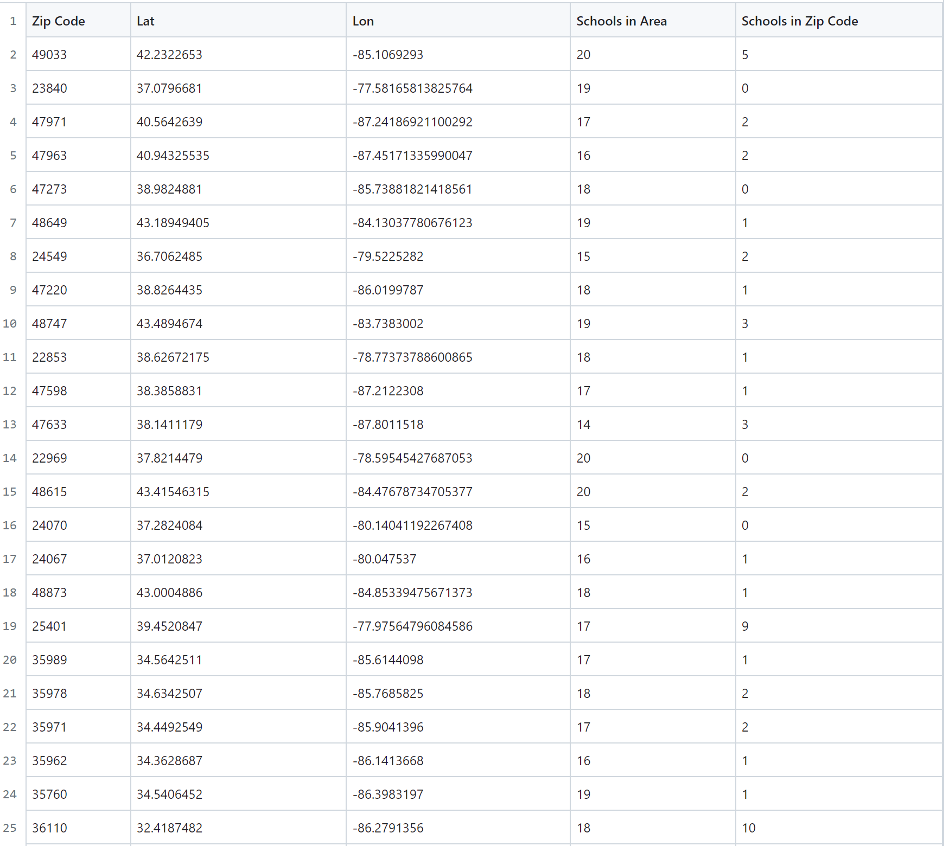
M

Slide 22
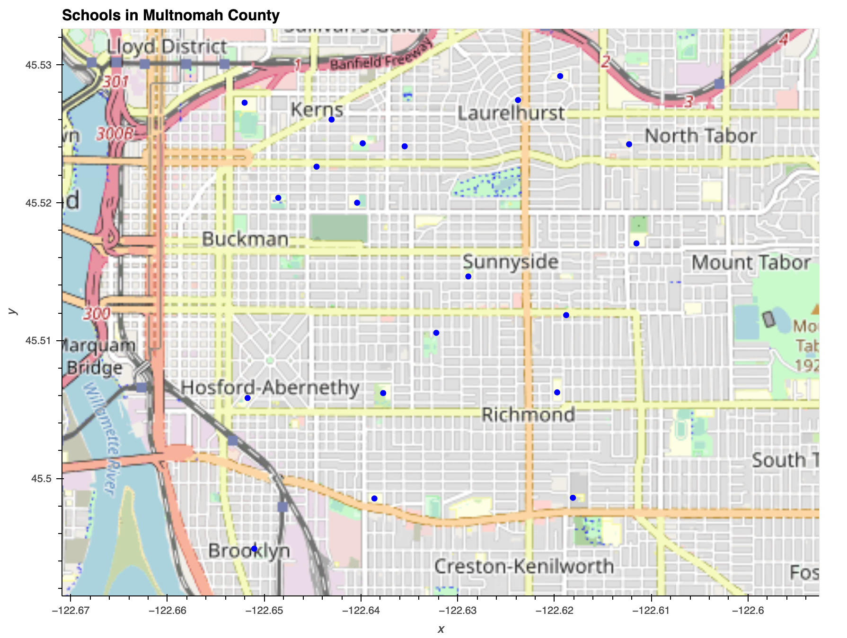
M

Slide 23
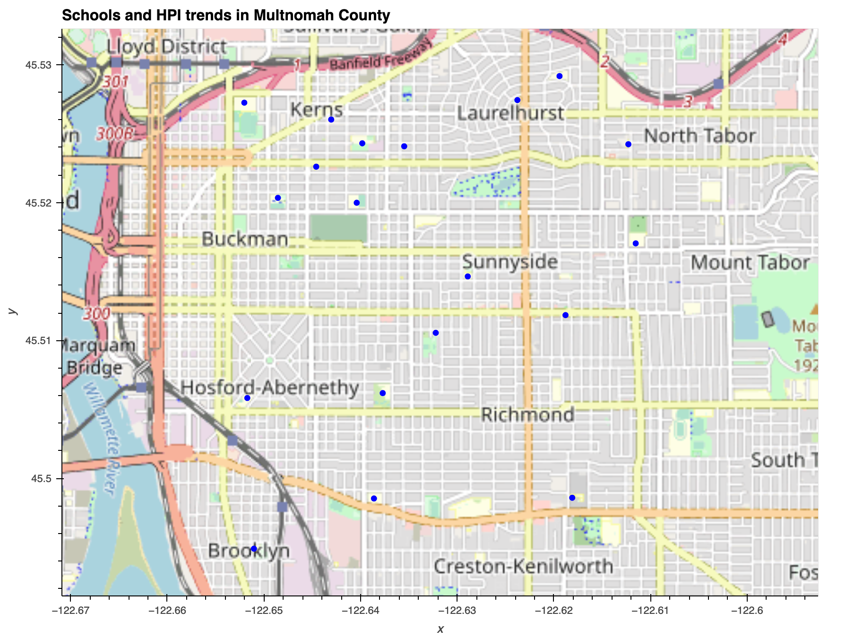
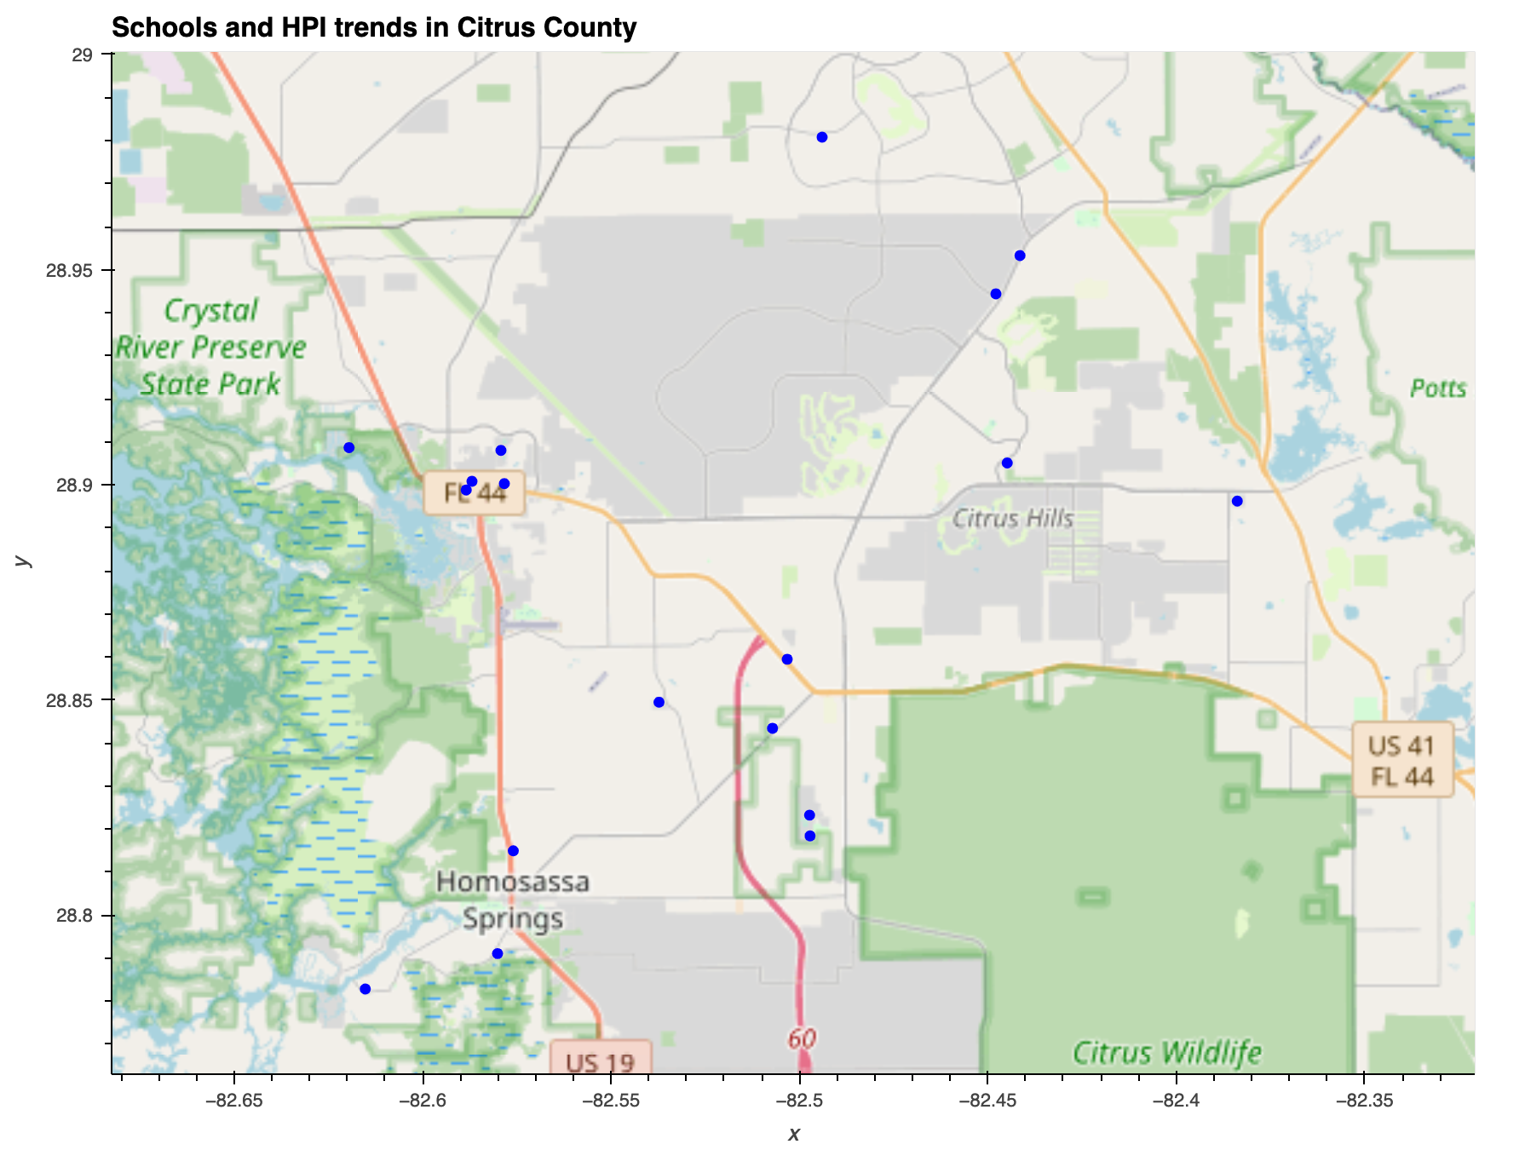
M
Average HPI: 1393.7742105263155
Average HPI: 380.92555555555566
19 vs 18

Slide 24
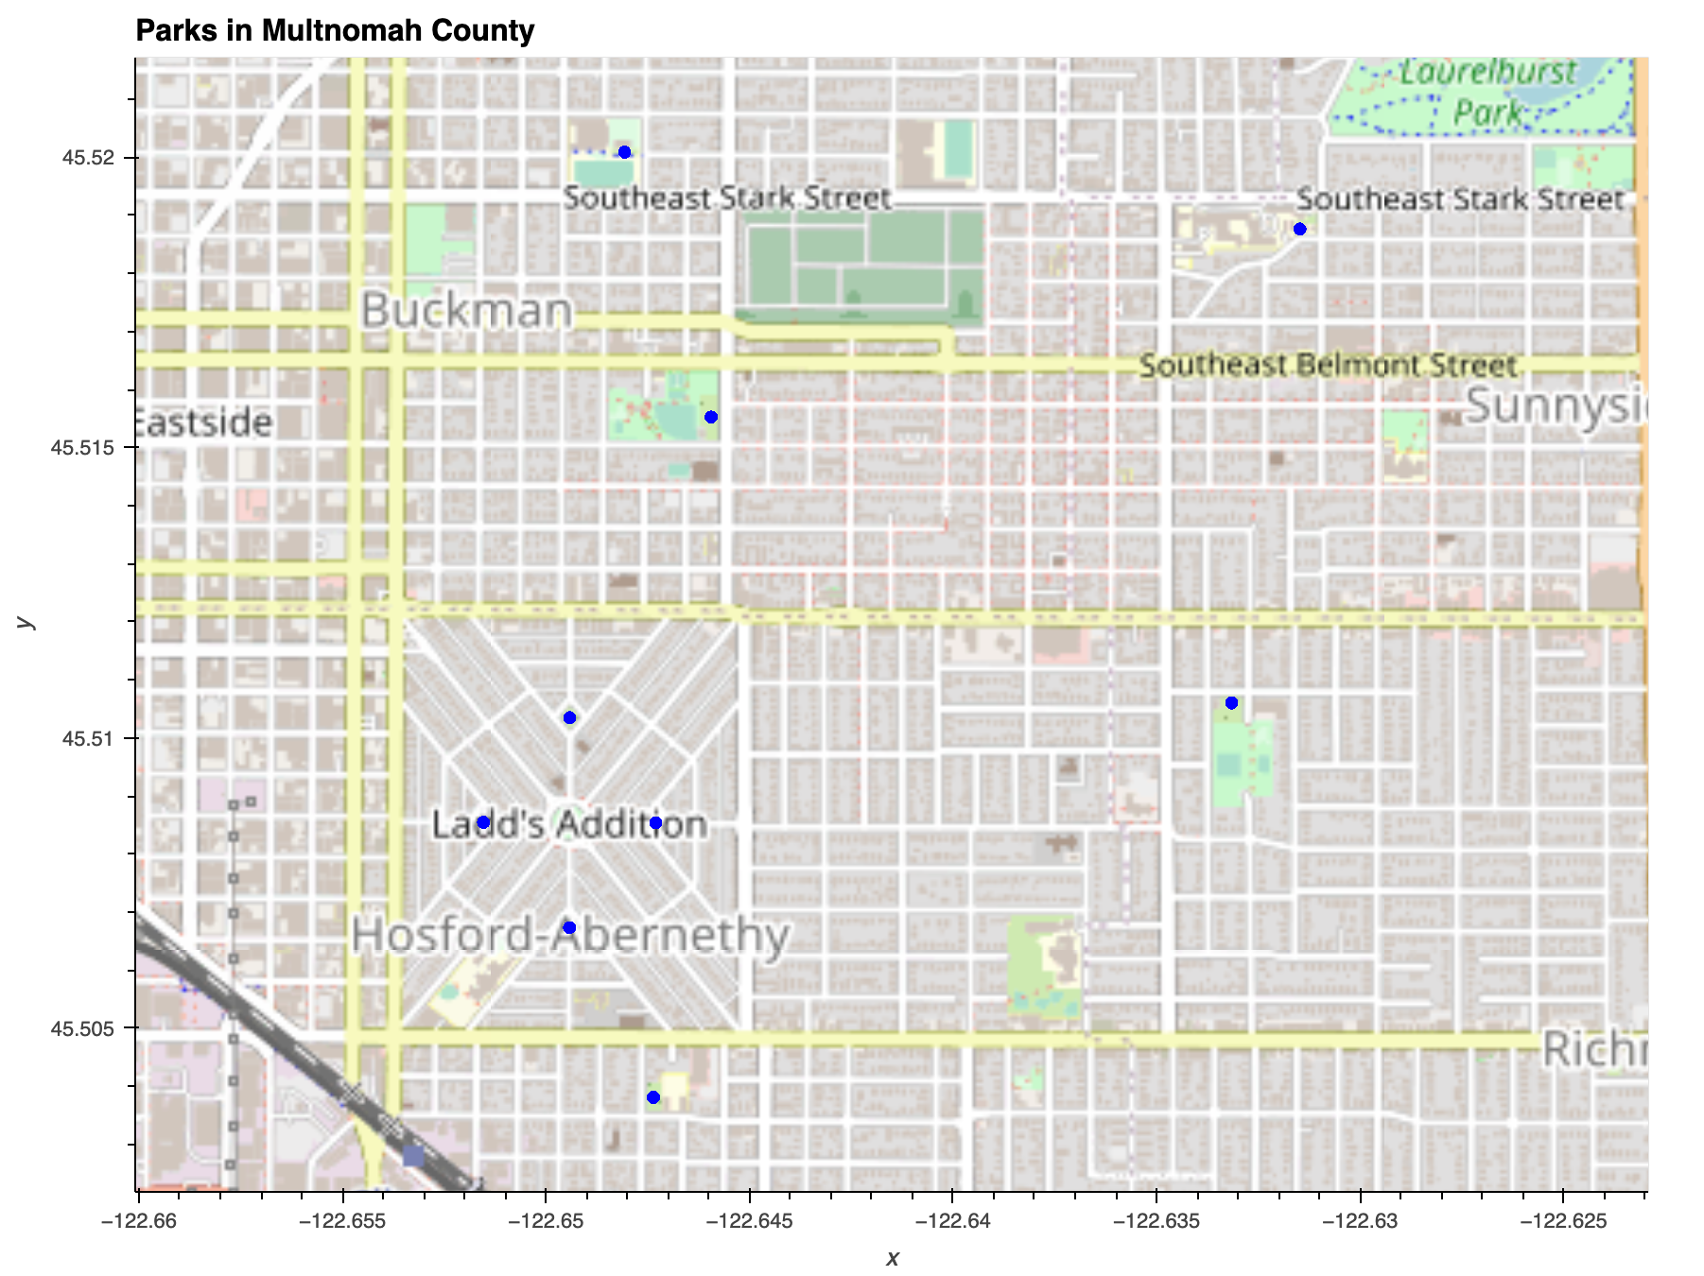
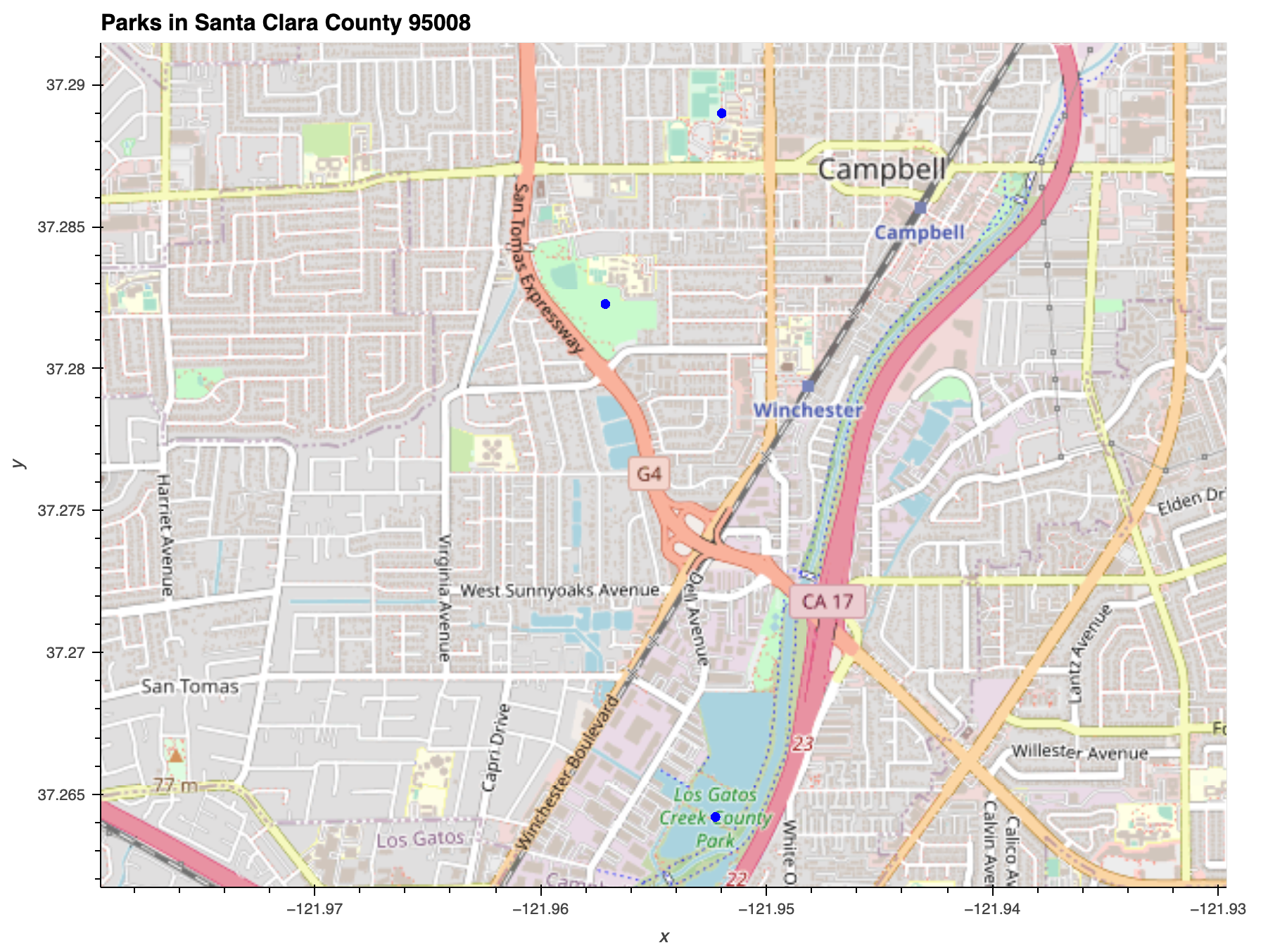
M

Slide 25
Schools & Parks Discussion
M
Findings:
The amount of schools and parks in the ZIP code does not appear to affect HPI within the ZIP codes that we investigated
Further Work:
Digging into school type (private/charter)
We selected limited ZIP codes of interest - comparing more ZIP codes at scale might reveal new findings

Slide 26
HPI & Macroeconomy
G
Impact of Recessions on HPI changes

Slide 27
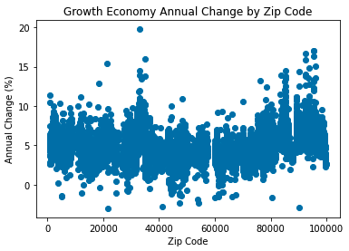
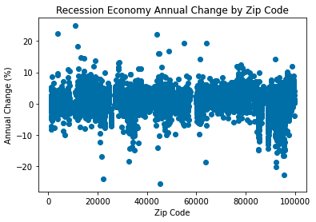
Economic Climate: Impact of Recessions on Prices
G
Recessions reduce growth (1.1% vs 5.0% in non-recession markets)
Some ZIP-codes grew even during recessions

Slide 28
Economic Climate: Outliers
G
Recession resistance: upper outliers that grew the most during recession years
Declining spaces: lower outliers that lost the most during non-recession years
Our data did not have values for all years; the growth side outliers are less meaningful
ZIP | Mean of Observed Annual Change (%)
10922 | 24.92 | Ft. Montgomery, NY
03846 | 22.39 | Jackson, NH
43840 | 22.27 | Stone Creek, OH
55087 | 19.28 | Warsaw, MN
64167 | 19.26 | Kansas City, MO
11930 | 18.28 | Amagansett, NY
48885 | 16.88 | Sidney, MI
44867 | 16.09 | Walnut Creek, OH
44454 | 16.07 | Petersburg, OH
13204 | 14.63 | Syracuse, NY
ZIP | Mean of Observed Annual Change (%)
21665 | -2.99 | Sherwood, MD
90212 | -2.93 | Beverley Hills, CA
41002 | -2.76 | Augusta, KY
54232 | -2.31 | St. Nazianz, WI
47456 | -2.28 | Quincy, ID
53937 | -1.86 | Hillpoint, WI
60029 | -1.65 | Gold, IL
80428 | -1.62 | Clark, CO
05261 | -1.49 | Pownal, VT
66075 | -1.48 | Pleasanton, KS
Year | Annual Change (%) | HPI
1993 | -18.24 | 81.76
1994 | -18.17 | 66.91
1999 | -8.16 | 96.77
2002 | -2.09 | 124.54
2003 | 12.78 | 140.45
2004 | 1.75 | 142.91
2005 | 10.72 | 158.23
2010 | -9.63 | 178.67
2011 | -4.78 | 170.13
2012 | 6.5 | 181.18
Missing years may limit usefulness of the data
Recession Resistance
Declining Spaces

Slide 29
Economic Climate Discussion
G
Findings
Recession years reduced avg growth from 5% to 1% nationally
Some ZIP codes appeared to grow every year regardless of overall trends
Missing years of data made the impact analysis difficult on a per-ZIP level, but overall trends were still visible
Further Work
More complete data would give a better picture of local-level sensitivity to the larger economy
Adding additional information, if available, such as local population changes and construction activity, could help explain local changes
A housing index prediction model could be built to test the sensitivity of any ZIP-code to factors that we have investigated:

Slide 30
Thank You

